Slide 1
SI_507 Web APIs & Authentication
Look back at your week 4 lesson 1 Web API notes!
Web APIs can offer security through Authentication
Authentication is basically ‘verifying identity’
Types of authentication for Web APIs include:
None
(iTunes, Star Wars API etc)
API Key
Users must get and use an API key
Used with public data
Prevent abuse rather than control access
Basic Authentication
Plain-text username & password as part of HTTP request
Not very secure
HTTPS protects packets in transition
HTTP Digest Authentication
Username & password encrypted before added to HTTP request
‘nonce’ – one-time code that expires, can be added
Oauth (Open Authorization)
An Open Standard in which users can grant permission to an App to access a web service for them (without giving passwords)
Covered in Lesson 2
Generic access/ Public data
User-specific access/ Personal Data

Slide 2
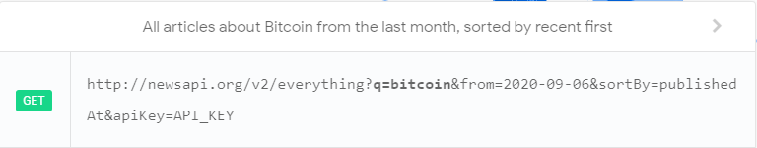
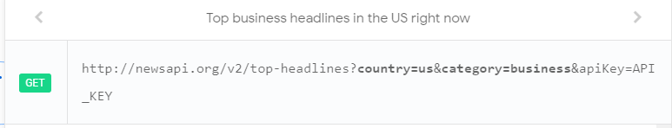
Practice with API Keys
Check out News API (http://newsapi.org)
Example 1
http://newsapi.org/v2/everything?q=bitcoin&from=2020-09-06&sortBy=publishedAt&apiKey=API_KEY
Example 2
http://newsapi.org/v2/top-headlines?country=us&category=business&apiKey=API_KEY
Learning Reinforcement
can you identify the Query in these two URLs?
Can you identify the Parameter?

Slide 3
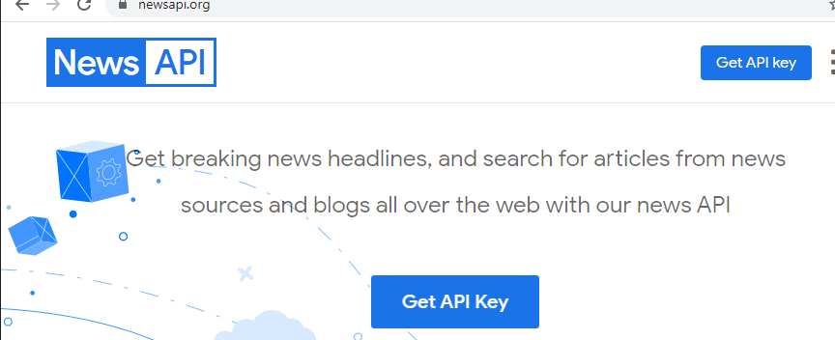
Practice with API Keys
Check out News API (http://newsapi.org)
Example 1
http://newsapi.org/v2/everything?q=bitcoin&from=2020-09-06&sortBy=publishedAt&apiKey=API_KEY
Example 2
http://newsapi.org/v2/top-headlines?country=us&category=business&apiKey=API_KEY
If you clicked through you would have seen that the URL doesn’t work because the parameter apiKey needs a real value to replace API_KEY

Slide 4
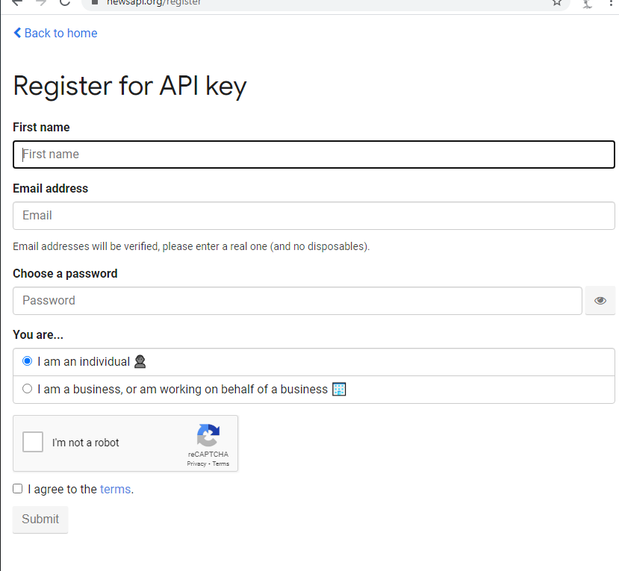
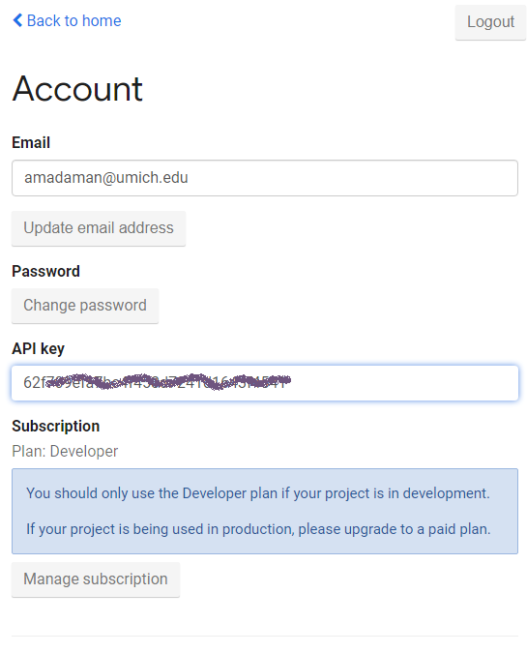
Practice with API Keys – Get API Key
Look back at your prior Web API notes!

Slide 5
Use Python to access Web API using API Key
Using command line, navigate to your SI 507 folder
Make a Directory for this week called webII-auth
Navigate into that directory and create a file called newsapi.py with the code below
import requests
NEWSAPI_KEY = 'THISISNOTAREALKEYPUTYOURKEYHERE'
base_url = 'https://newsapi.org/v2/top-headlines'
params = {
"apiKey": NEWSAPI_KEY
}
response = requests.get(base_url, params)
result = response.json()
print(result)
Look at the output that you get
Respond by adding the param “country”: “us”
Test your understanding (10 minutes) –
Using the documentation: https://newsapi.org/docs/endpoints/top-headlines
Modify your program to print out the headline and source name for all articles with the keyword “infrastructure”

Slide 6
Extension 2
Using what you know about modules – modify newsapi.py to access the necessary API_Key from secrets.py

